Slide 1
AUGUST FINANCIAL REPORT
Board Meeting August 22, 2024

Slide 2
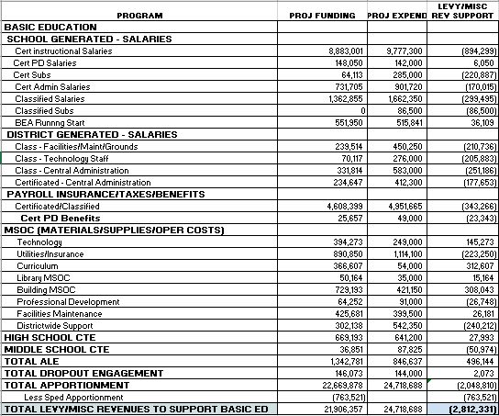
BEA Projected Revenues, Expenditures - July 2024

Slide 3
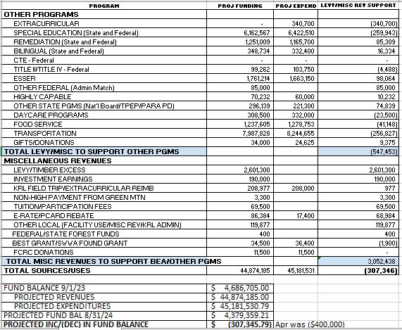
Other Program Projected Revenues, Expenditures and Ending Fund Balance - July 2024
Ending Fund Balance is projected to decrease by approximately $307,000. This is about $100,000 more favorable than the April projections and $400,000 more favorable than the budget. Revenues are about $260,000 less than budget. In most cases revenues were greater than budgeted, but were considerably less in property taxes and KWRL unfunded. Expenditures are approximately $690,000 less than budgeted. There are many areas where the budget was overspent, but underspending in extracurricular and transportation are big factors in this difference. The 24-25 budget is projecting a starting fund balance of $4.3M and according to this update, the district will be able to meet that projected amount and possibly could have a slightly higher actual fund balance.

Slide 4
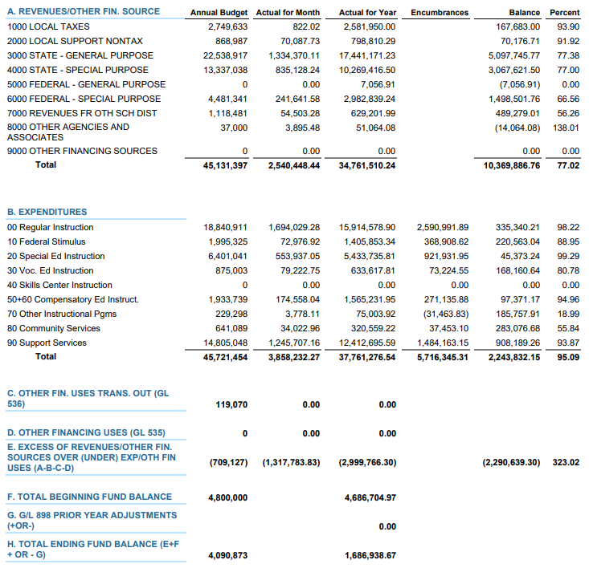
JUNE 2024 BUDGET STATUS REPORT – GENERAL FUND

Slide 5
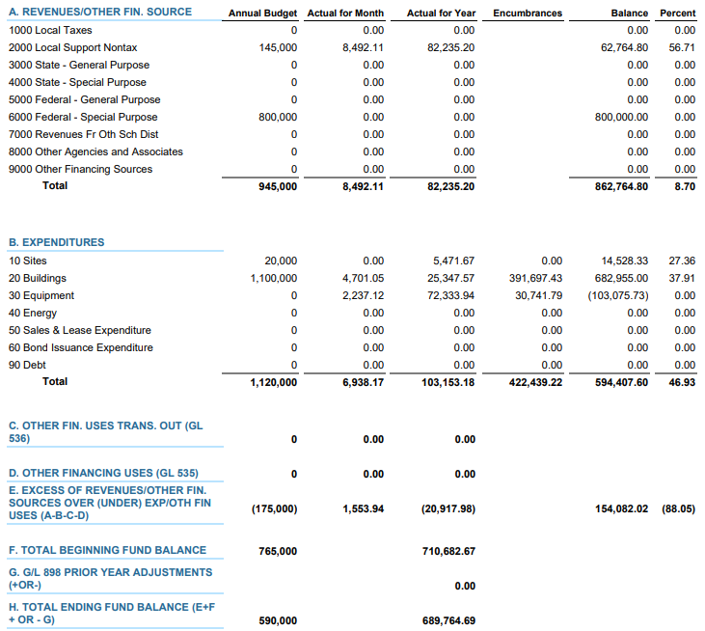
JUNE 2024 BUDGET STATUS REPORT – CAPITAL PROJECTS FUND

Slide 6
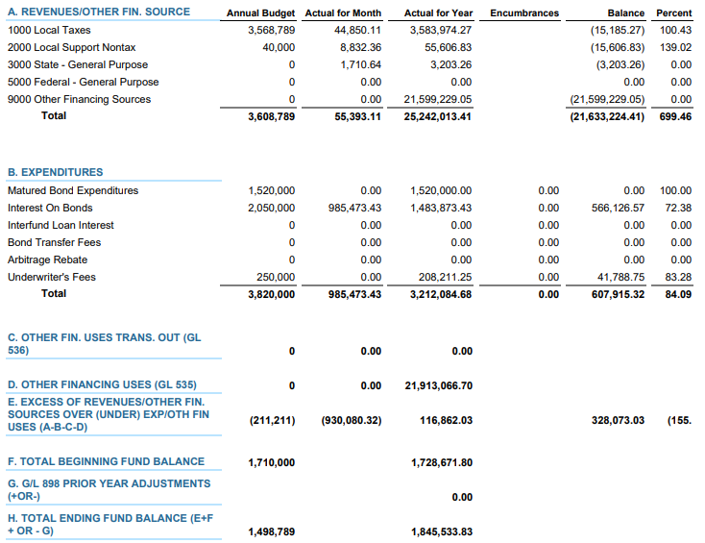
JUNE 2024 BUDGET STATUS REPORT – DEBT SERVICE FUND

Slide 7
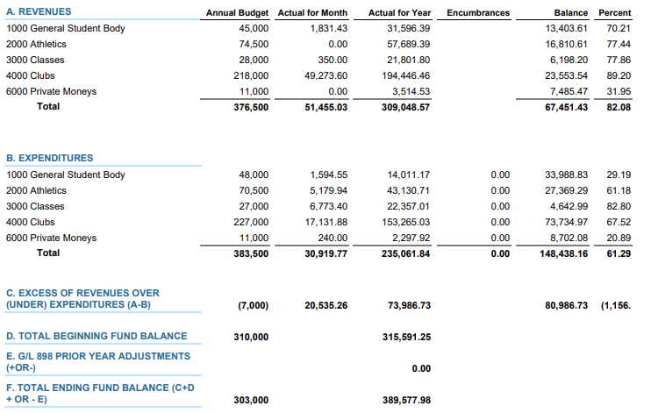
JUNE 2024 BUDGET STATUS REPORT – ASB FUND

Slide 8
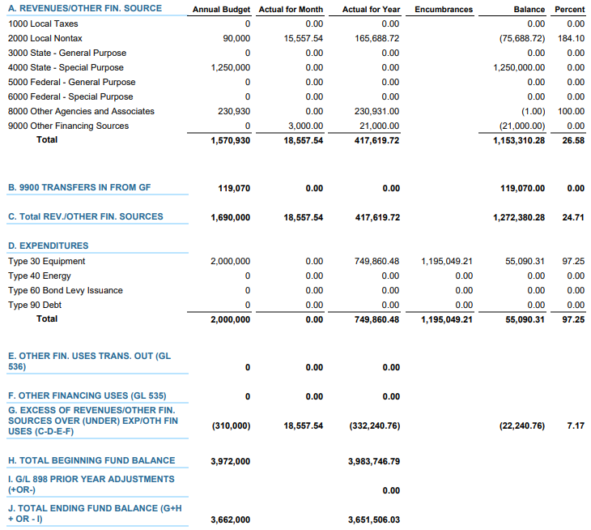
JUNE 2024 BUDGET STATUS REPORT – TRANSPORTATION VEHICLE FUND

Slide 9
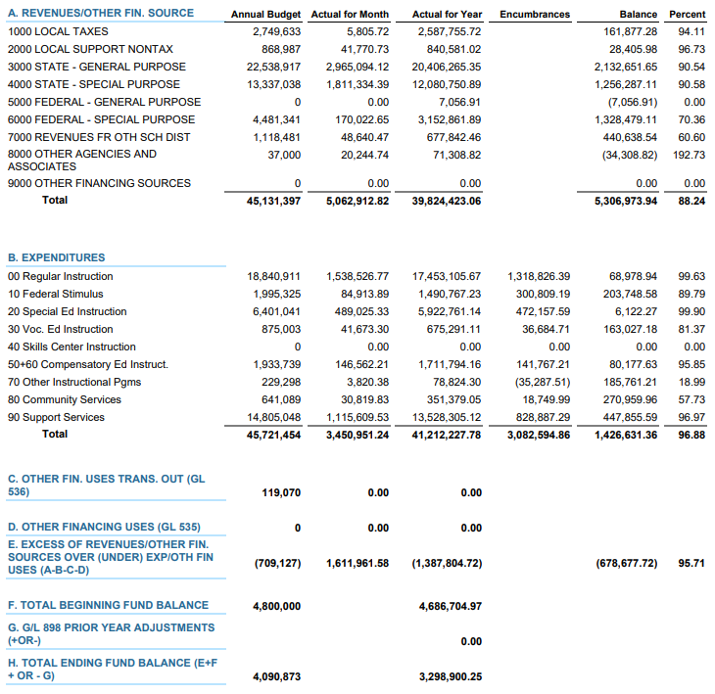
JULY 2024 BUDGET STATUS REPORT – GENERAL FUND

Slide 10
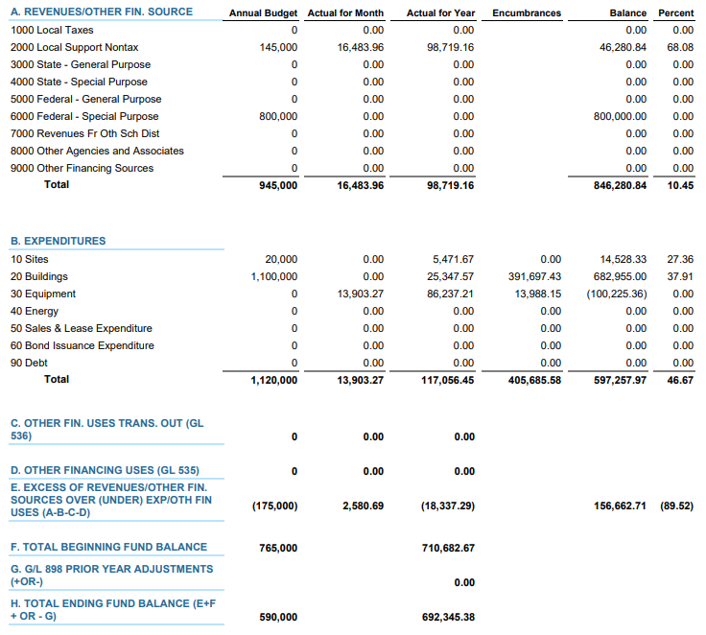
JUly 2024 BUDGET STATUS REPORT – CAPITAL PROJECTS FUND

Slide 11
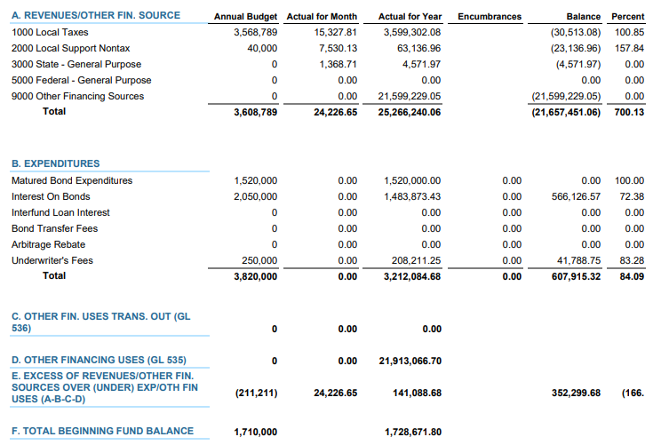
JULY 2024 BUDGET STATUS REPORT – DEBT SERVICE FUND

Slide 12
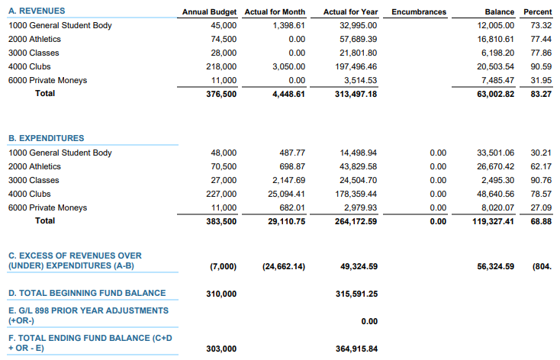
JULY 2024 BUDGET STATUS REPORT – ASB FUND

Slide 13
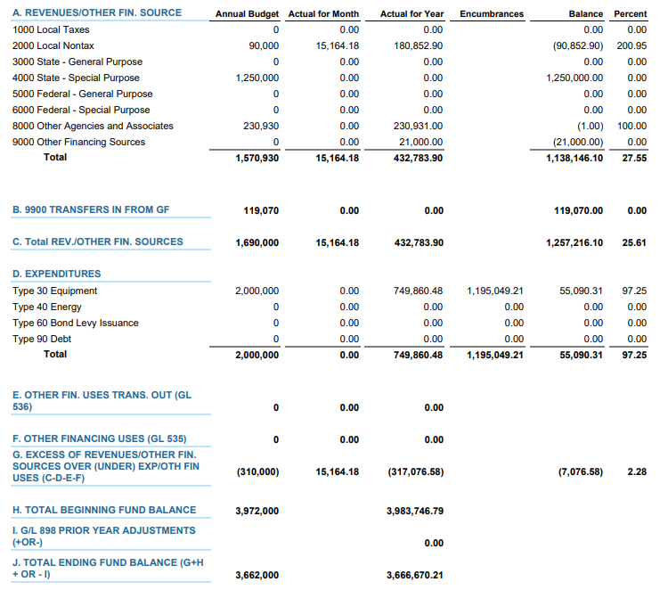
JULY 2024 BUDGET STATUS REPORT – TRANSPORTATION VEHICLE FUND

